Slide 1
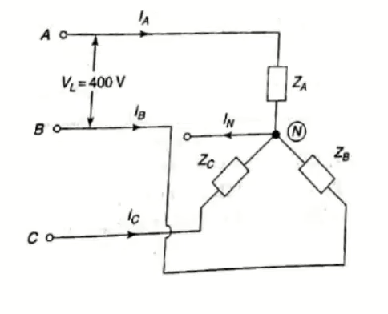
1. A 400V, 3phase 4 wire system of the figure has a star connected load with Z_{A} = 10ohm, Z_{B}= 15+j10 ohm and Z_{C} = j5 ohm. Find the line currents and current through the neutral conductor.
Phase currents:
I_{A} = 23.094 A, 0º
I_{B} = 12.81A , -153.69º
I_{C}= 46.19A , 30º
I_{N}= 54.47A, 18.65º

Slide 2
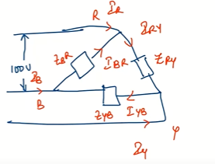
2. A 100V, 3phase 3 wire supply feed an unbalanced star connected load with an impedance of Z_{R} =5ohm, Z_{Y} = j2 ohm and Z_{B}= -j4 ohm, find the phase and line currents using star delta transformation.
Phase currents:
I_{RY} = 31.25, -38.66º A
I_{YB}= 39.06, -68.66º A
I_{BR}= 15.63,-98.66º A
Line currents:
I_{R}= 27.06, -8.65º A
I_{Y}= 19.7, -121.14º A
I_{B}= 26.69, 128.36º A

Slide 3
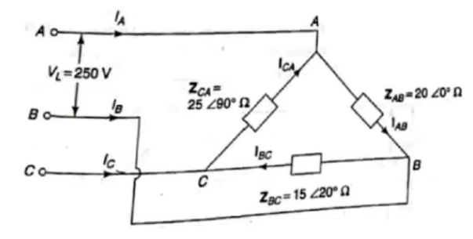
2. A three phase supply with a line voltage of 250V has an unbalanced delta load as shown in the figure. Determine the phase and line currents, total active and reactive power if the phase sequence is ABC
Phase currents:
I_{AB}= 12.5 A, 0º, I_{BC}= 16.66 A, -140º
I_{CA}= 10 A, -330º
Line currents:
I_{A} = 6.3 A, -52.48º, I_{B}= 27.45 A, -157.02^{O},
I_{C}= 26.57A, 36.25º
Active power:
P_{AB} = 3.13kW, P_{BC}= 3.92kW, P_{CA}= 0W,
Pt= 7.05kW
Reactive power:
Q_{AB}= 0kVAR, Q_{BC}= 1.43kVAR, Q_{CA}= 2.5kVAR
Qt= 3.93kVAR

Slide 4
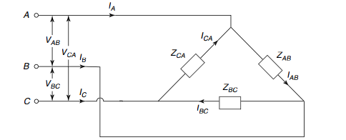
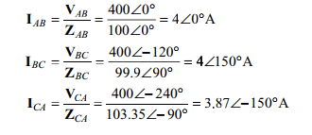

5. In the circuit, a 400 V, 50 Hz, 3-phase supply of phase sequence ABC is supplied to a delta-connected load consisting of a 100 W resistor between lines A and B, a 378 mH inductor between lines B and C, and a 37.8 μF capacitor between lines C and A. Determine phase and line currents.
Phase currents
line currents

Slide 5
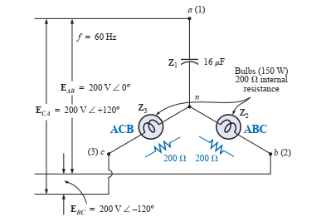
5. Calculate the phase currents of b and c and find out which bulb glows brighter.
Ic =0.259, 123.06deg
Ib = 0.91 , 225.36 deg
Bulb ABC glows brighter

Slide 6
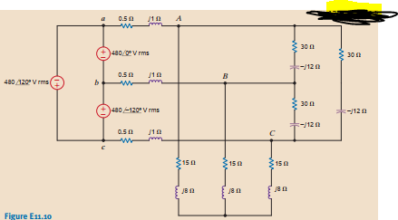

6. Find the line currents and the power absorbed by the delta-connected load

